Slide 1

CROWDFUNDING ANALYSIS PROJECT
Group-3
1.Nivedita Yadav
2.Gandham Sowmya
3.Sunayana Mahekar
4.Shreyal Gedam
5.Anuja Shrivastava
6.Archana Parmar
7.Gopisetty SaiPavanKalyan

Slide 2
1.Introduction
2.Data Overview
3.Objectives : KPIs
4.Dashboard
5.Analysis
6.Recommendations & Insights
7.Conclusion
Contents
Notes:
1.Introduction
2.Data Overview
3.Objectives : KPIs
4.Dashboard
5.Analysis
6.Recommendations and Insights
7.Conclusion

Slide 3
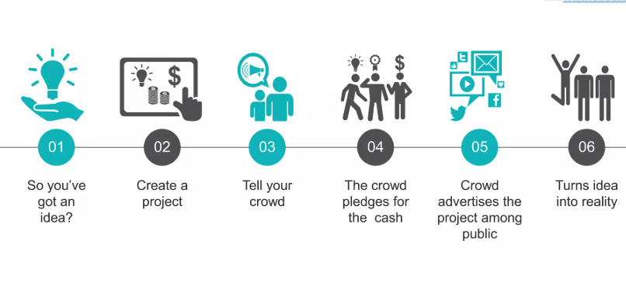
Crowdfunding is a collective effort by people who network and contribute collectively for a cause or a business idea.
“Crowdfunding is the practice of funding a project or venture by raising many small amounts of money from a large number of people, typically via internet”
Offers individuals or businesses a chance to succeed by showcasing their businesses and projects to entire world.
Alternative solution to lack of funds.
Introduction
Notes:
1.Introduction
2.Data Overview
3.Objectives : KPIs
4.Dashboard
5.Analysis
6.Recommendations and Insights
7.Conclusion

Slide 4
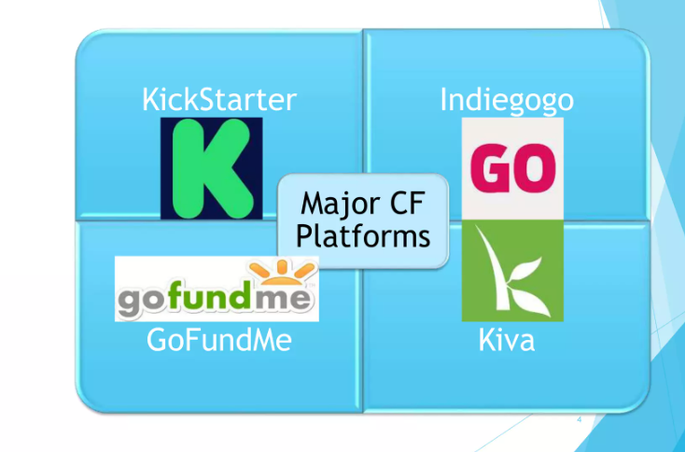
Major crowd Funding Platforms
Notes:
1.Introduction
2.Data Overview
3.Objectives : KPIs
4.Dashboard
5.Analysis
6.Recommendations and Insights
7.Conclusion

Slide 5

By analyzing this dataset, we aim to understand the performance of the CROWDFUNDING Dataset, identify trends and extracts valuable insights to drive business growth and improve overall efficiency.
Analysis tools: Excel, MySQL, Power BI, Tableau
The project will involve exploring different aspects of Kickstarter, including its crowdfunding model, how it supports creative projects, the role of backers, and its business model.
It will also delve into the reasons why people back projects, the rewards system, and the platform's impact on innovation and creativity.
Data Overview
Notes:
1.Introduction
2.Data Overview
3.Objectives : KPIs
4.Dashboard
5.Analysis
6.Recommendations and Insights
7.Conclusion

Slide 6
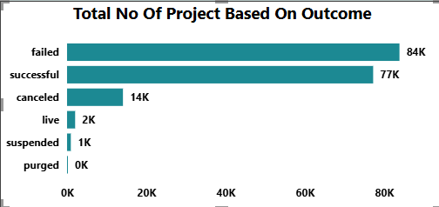
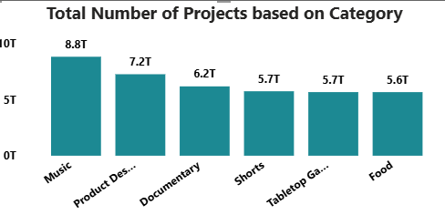
Total No. of Projects Based on Outcome:
KPI’S
The number of projects categorized by success or failure:
Failed: 84K, Successful: 77K, Canceled: 14K
Almost half of the projects fail to reach their goal.
A slightly lower number of projects succeed, indicating tough competition.
Some projects get canceled or suspended due to various reasons (rules violation, lack of interest, etc.).
Total Number of Projects Based on Category:
The number of projects across different categories: Music: 8.8T, Product Design: 7.2T, Documentary: 6.2T Short Films: 5.7T, Tabletop Games: 5.7T, Food: 5.6T
Music and Product Design are the most popular categories.
People are highly interested in supporting creative arts, technology, and innovation.
Some industries (e.g., food) have lower funding, possibly due to higher risks or costs.
Notes:
1.Introduction
2.Data Overview
3.Objectives : KPIs
4.Dashboard
5.Analysis
6.Recommendations and Insights
7.Conclusion

Slide 7
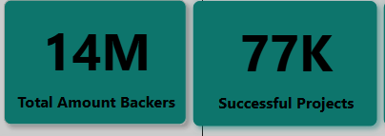
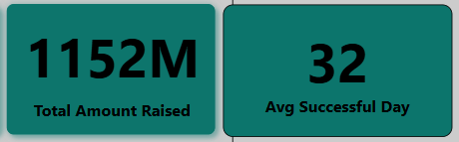
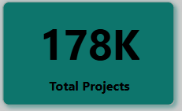
Total Amount Backers & Successful Projects
The total number of people who have backed crowdfunding projects (14M).
The number of successfully funded projects (77K).
The average duration of a successful project (32 days)
A high number of backers suggests strong engagement, but the success rate depends on project quality, marketing, and funding goals.
Total Amount Raised & Total Projects
The total amount of money raised across all projects (1,152M or 1.15B).
The total number of crowdfunding projects launched (178K).
Although many projects have been launched, only a fraction reached their funding goal. The total funds raised indicate the significant impact of crowdfunding.
Notes:
1.Introduction
2.Data Overview
3.Objectives : KPIs
4.Dashboard
5.Analysis
6.Recommendations and Insights
7.Conclusion

Slide 8
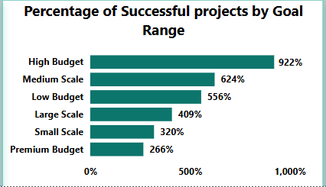
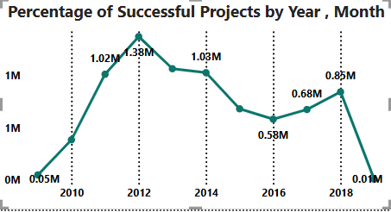
Percentage of Successful projects by Goal Range
Success rates for different funding goal ranges.
Highest success rates by budget category:
High Budget (556%)
Small Scale (320%)
Premium Budget (266%)
Larger budgets tend to have higher success rates, possibly due to strong marketing and established backers.
Smaller-scale projects also succeed, as they have lower financial goals. Success rates for different goal ranges.
Medium-scale projects have a 623.54% success rate.
Medium-range funding goals seem to have the best success rate.
Projects that aim for moderate funding may have a higher chance of meeting their goal than those with very high or very low targets.
Percentage of Successful Projects by Year Month
The trend of successful projects over time.
Peaks in 2012 (1.38M), 2013 (1.03M), and 2014 (1.03M).
Success rates peaked around 2012-2014 and have since declined.
This may indicate increased competition or changing crowdfunding dynamics.
Notes:
1.Introduction
2.Data Overview
3.Objectives : KPIs
4.Dashboard
5.Analysis
6.Recommendations and Insights
7.Conclusion

Slide 9
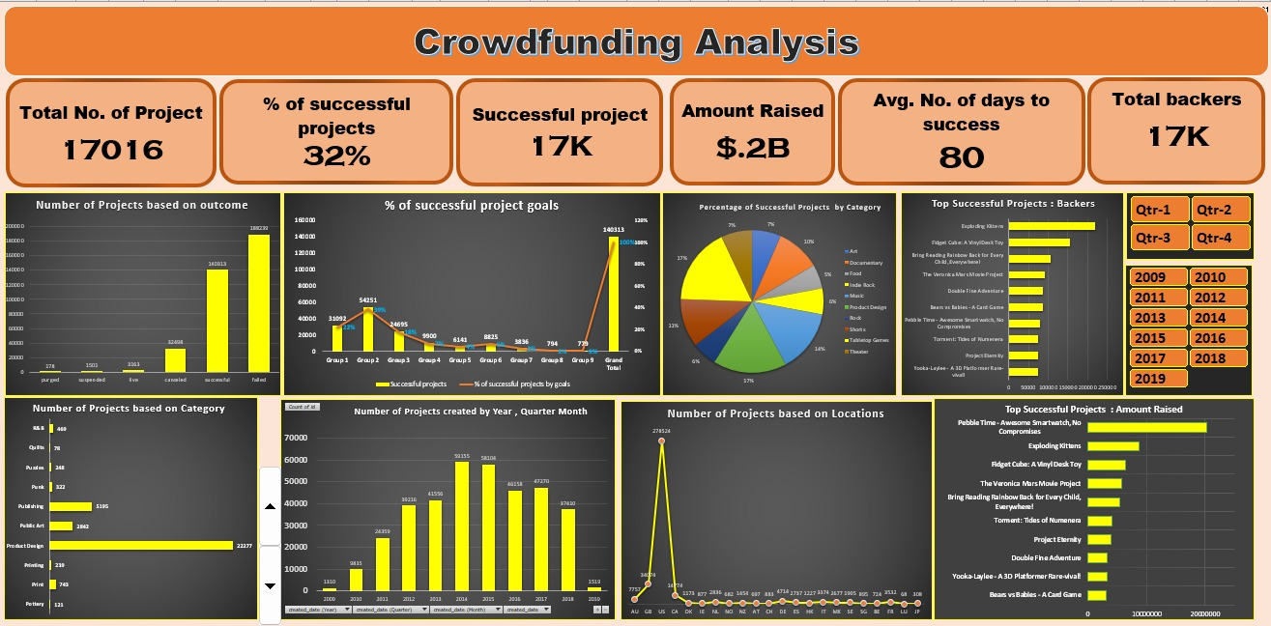
Excel Dashboard
Notes:
1.Introduction
2.Data Overview
3.Objectives : KPIs
4.Dashboard
5.Analysis
6.Recommendations and Insights
7.Conclusion

Slide 10
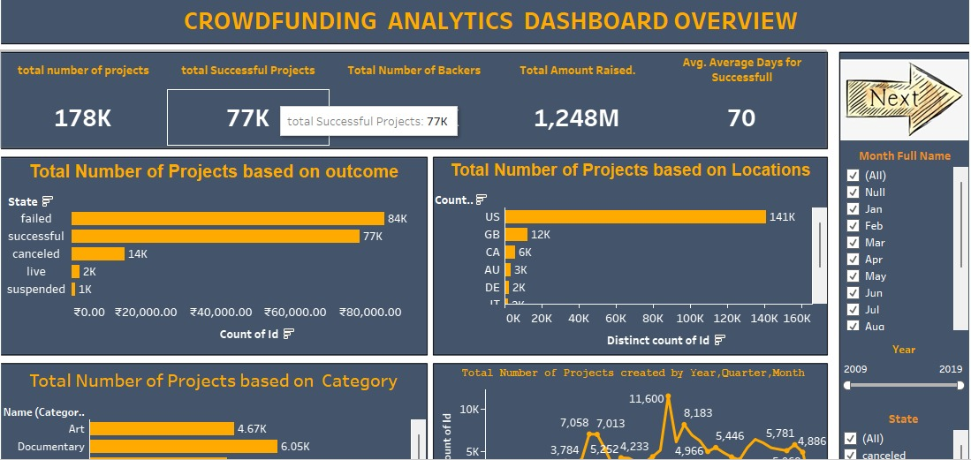
Tableau Dashboard
Notes:
1.Introduction
2.Data Overview
3.Objectives : KPIs
4.Dashboard
5.Analysis
6.Recommendations and Insights
7.Conclusion

Slide 11
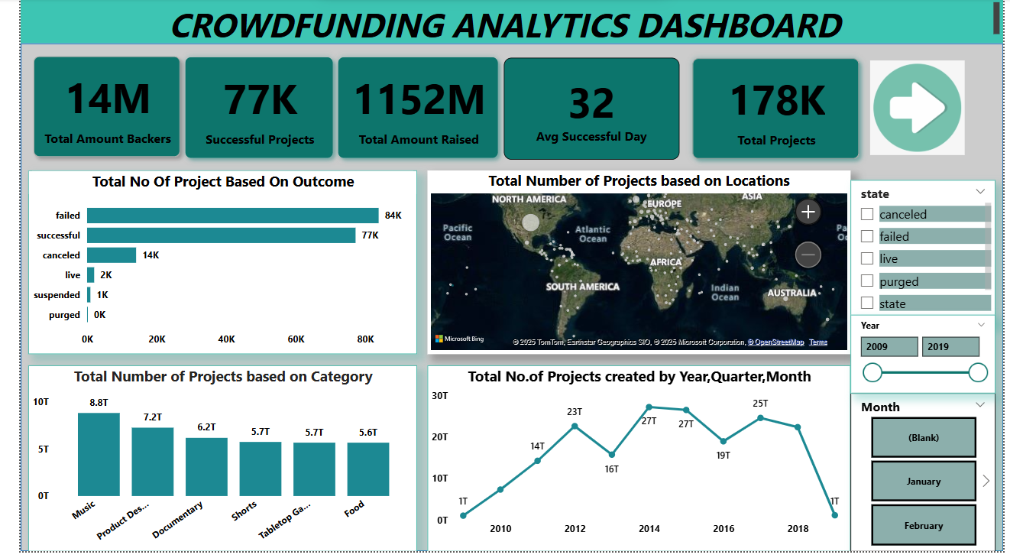
Power bi Dashboard
Notes:
1.Introduction
2.Data Overview
3.Objectives : KPIs
4.Dashboard
5.Analysis
6.Recommendations and Insights
7.Conclusion

Slide 12
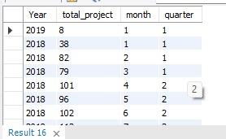
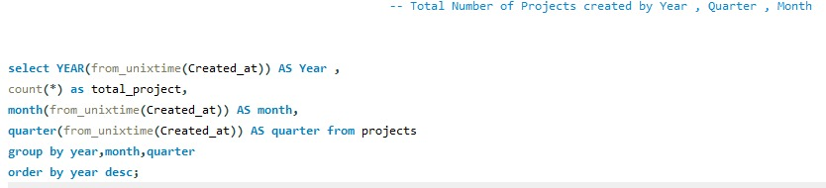
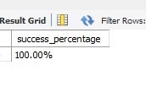
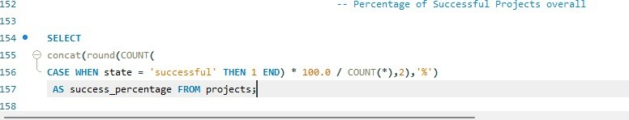
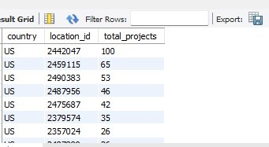
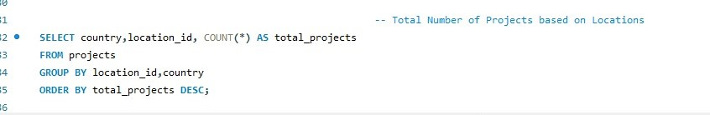
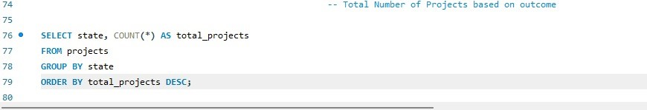
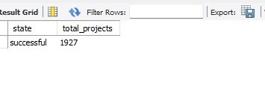
SQL Overview
Notes:
1.Introduction
2.Data Overview
3.Objectives : KPIs
4.Dashboard
5.Analysis
6.Recommendations and Insights
7.Conclusion

Slide 13
SQL Overview
Notes:
1.Introduction
2.Data Overview
3.Objectives : KPIs
4.Dashboard
5.Analysis
6.Recommendations and Insights
7.Conclusion

Slide 14

Almost half of the projects fail to reach their funding goal, indicating high competition.
A slightly lower number of projects succeed, suggesting that strategic planning and marketing are crucial.
Music and Product Design are the most popular categories.
Backers are highly interested in creative arts, technology, and innovation.
Categories like food face lower funding, possibly due to higher costs and risks.
A high number of backers suggests strong engagement, but project success depends on quality, marketing, and funding goals.
Analysis
Notes:
1.Introduction
2.Data Overview
3.Objectives : KPIs
4.Dashboard
5.Analysis
6.Recommendations and Insights
7.Conclusion

Slide 15
Larger budgets tend to have higher success rates, likely due to strong marketing and investor trust.
Smaller-scale projects also perform well as they have lower financial goals.
Medium-scale projects have the highest success rate (623.54%).
Projects aiming for moderate funding have a higher chance of reaching their goal compared to very high or very low targets.
Analysis
Notes:
1.Introduction
2.Data Overview
3.Objectives : KPIs
4.Dashboard
5.Analysis
6.Recommendations and Insights
7.Conclusion

Slide 16

Set Realistic Funding Goals: Medium-scale projects show the highest success rates, suggesting that setting practical and achievable financial targets improves the likelihood of success.
Develop a Strong Marketing Strategy: Effective promotional campaigns, influencer collaborations, and compelling storytelling can increase visibility and attract more backers.
Engage Backers with Incentives: Offering exclusive rewards, early-bird discounts, and stretch goals can help maintain interest and increase contributions.
Optimize Campaign Duration: The average duration of successful projects is 32 days, suggesting that campaigns should be neither too short nor too long to maximize engagement and funding potential.
Recommendations & Insights
Notes:
1.Introduction
2.Data Overview
3.Objectives : KPIs
4.Dashboard
5.Analysis
6.Recommendations and Insights
7.Conclusion

Slide 17

In conclusion, after analyzing data from numerous crowdfunding projects, we've identified clear patterns that contribute to both success and failure.
Our findings show that projects with [Music, Documentary, Product Design, Short Films, Tabletop Games, Food] have a significantly higher success rate, while those lacking often struggle to meet their targets.
The success rate across the projects we examined was 32%.
By sharing these insights and data-backed strategies, we hope to help future creators improve their chances of running successful campaigns. Understanding these trends and learning from both successes and failures is crucial for maximizing the potential of any crowdfunding effort.
Conclusion
Notes:
1.Introduction
2.Data Overview
3.Objectives : KPIs
4.Dashboard
5.Analysis
6.Recommendations and Insights
7.Conclusion

Slide 18

Thank You!!
Notes:
1.Introduction
2.Data Overview
3.Objectives : KPIs
4.Dashboard
5.Analysis
6.Recommendations and Insights
7.Conclusion

